Slide 1

Hyperparameter Tuning

Slide 2
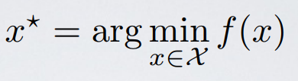
Hyperparameters
Parameters that the model doesn’t learn
Determine the shape and functioning of the model
Dramatic impact on performance
Degree in polynomalial regression
Number of hidden layers
Number of neurons in a given layer

Slide 3
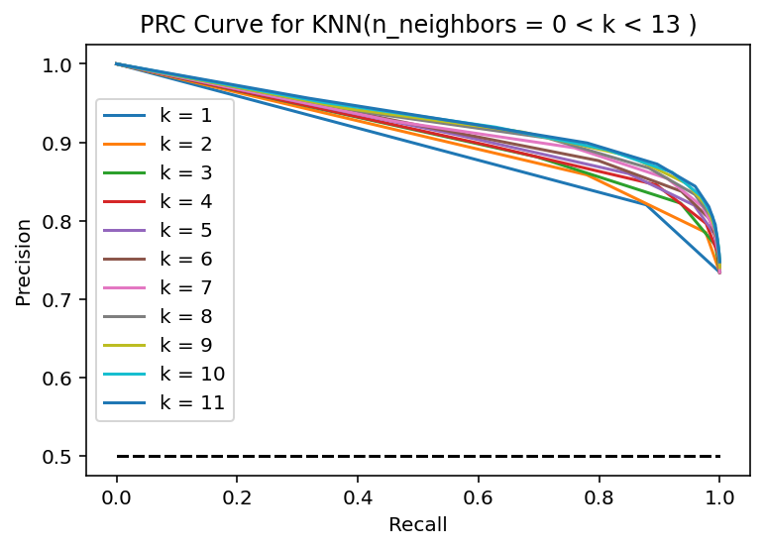
Hyperparameter Tuning
By Hand?
What indicators to watch?

Slide 4
Train/validation/test sets
Train set: used for training parameters
Validation set: used to monitor hyperparameters
Test set: used to assess performance
Why do we need a validation set?
Example: polynomial regression. split data set in 70/20/10. Train with k=3 on the 70, test it on the 20. Retrain with k=5 on the 70, test it on the 20. Take the best performing one and test it against the 10. That’s the final assessment

Slide 5

K-fold cross validation
More sophisticated validation methods

Slide 6
Automated hyperparameter tuners (autotuner)
Systematic ways to try out hyperparameters?
Random Search: random combination of hyperparameters
Grid Search: enumerates hyperparameter space and tries combinations
Bayesian Optimization: directs search where improvement is more likely
Hyperband: similar to random search, but allocates different time to different configurations

Slide 7
Random search
Tries random combination of hyperparameters
Returns the best performing model according to a specified indicator (like validation loss)

Slide 8
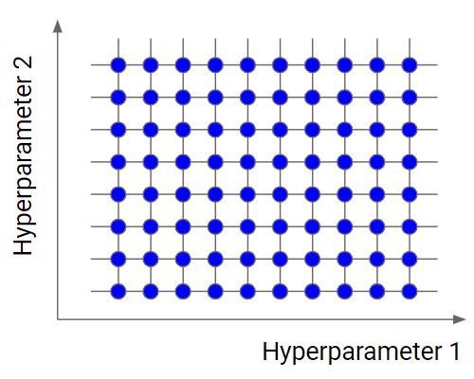
Grid search
Enumerates hyperparameter space and tries combinations
Follows an enumeration order (unlike random search)
Pick point of the grid that maximises indicator

Slide 9
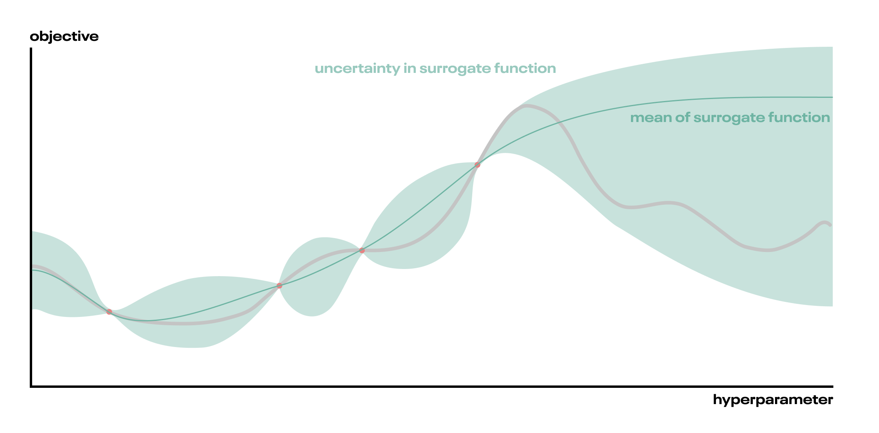
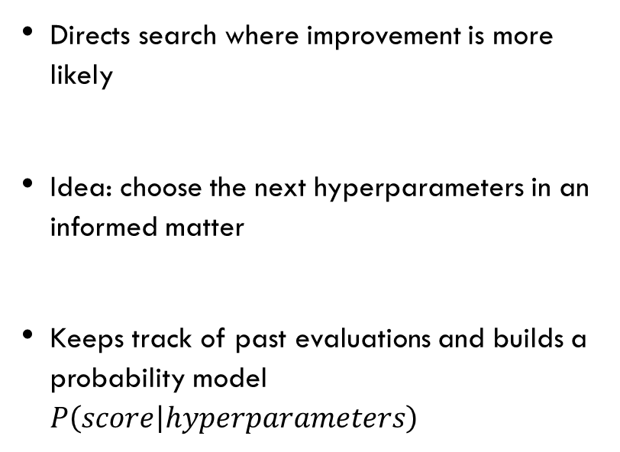
Bayesian optimization
Directs search where improvement is more likely
Idea: choose the next hyperparameters in an informed matter
Keeps track of past evaluations and builds a probability model $P\left(score | hyperparameters\right)$

Slide 10
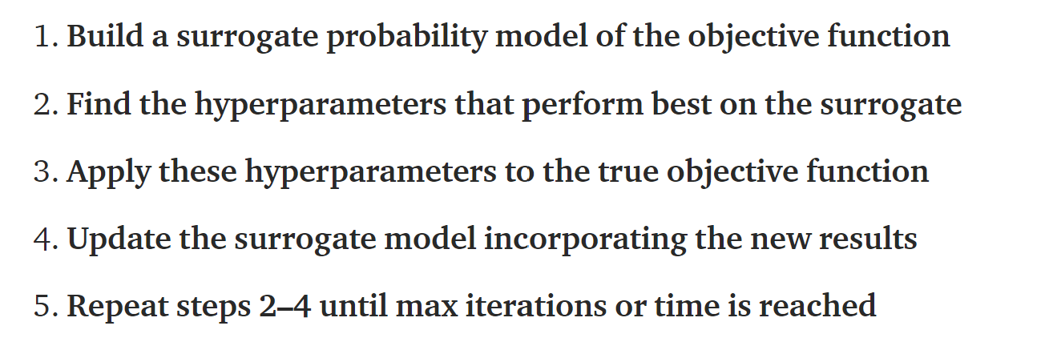

Bayesian optimization
$$P\left(score | hyperparameters\right)$$
Usually validation loss
Easier task compared to objective function
Surrogate Model:
probability representation of the objective function built using previous evaluations
Credits: Will Koehrsen’s blog

Slide 11
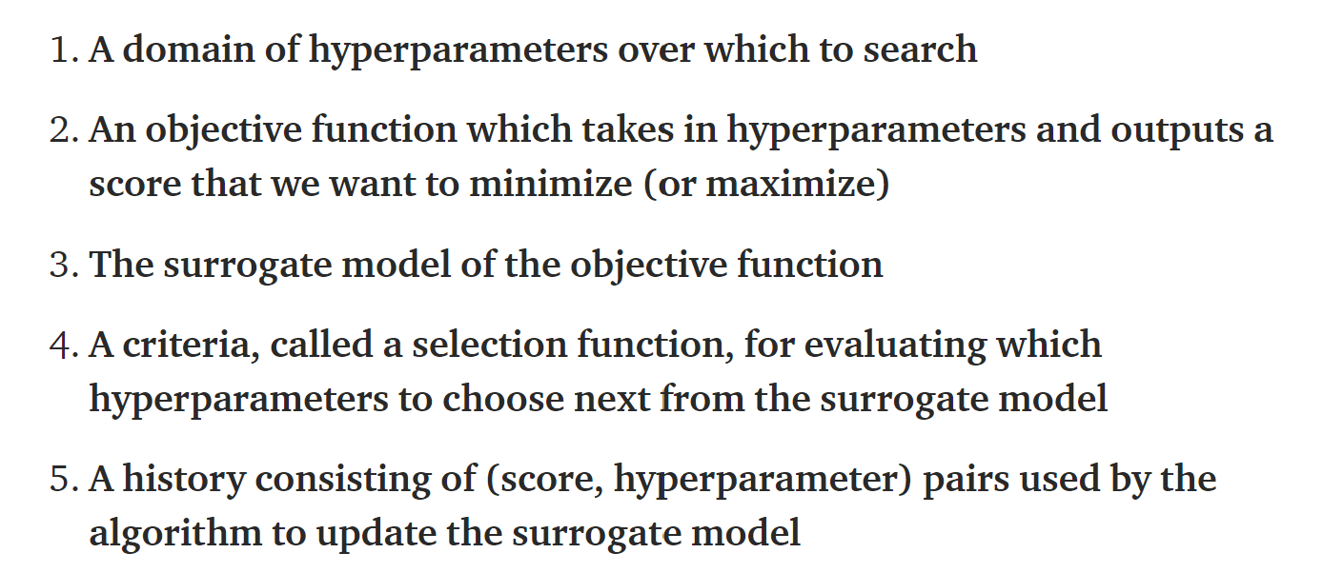
Bayesian optimization
Key ingredients:
e.g. MSE
Various implementations

Slide 12
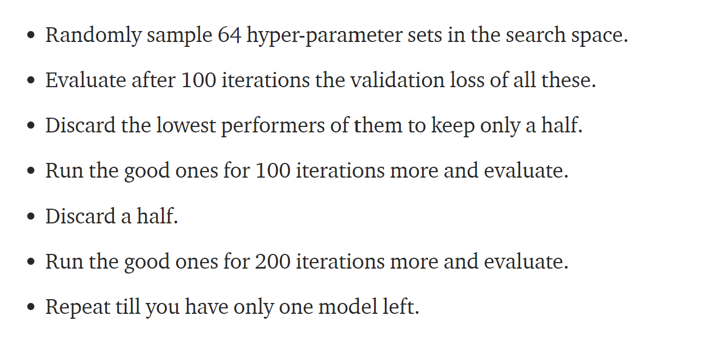

Hyperband
Similar to random search, but allocates different time to different configurations
Iteration: $n$ epochs

Slide 13
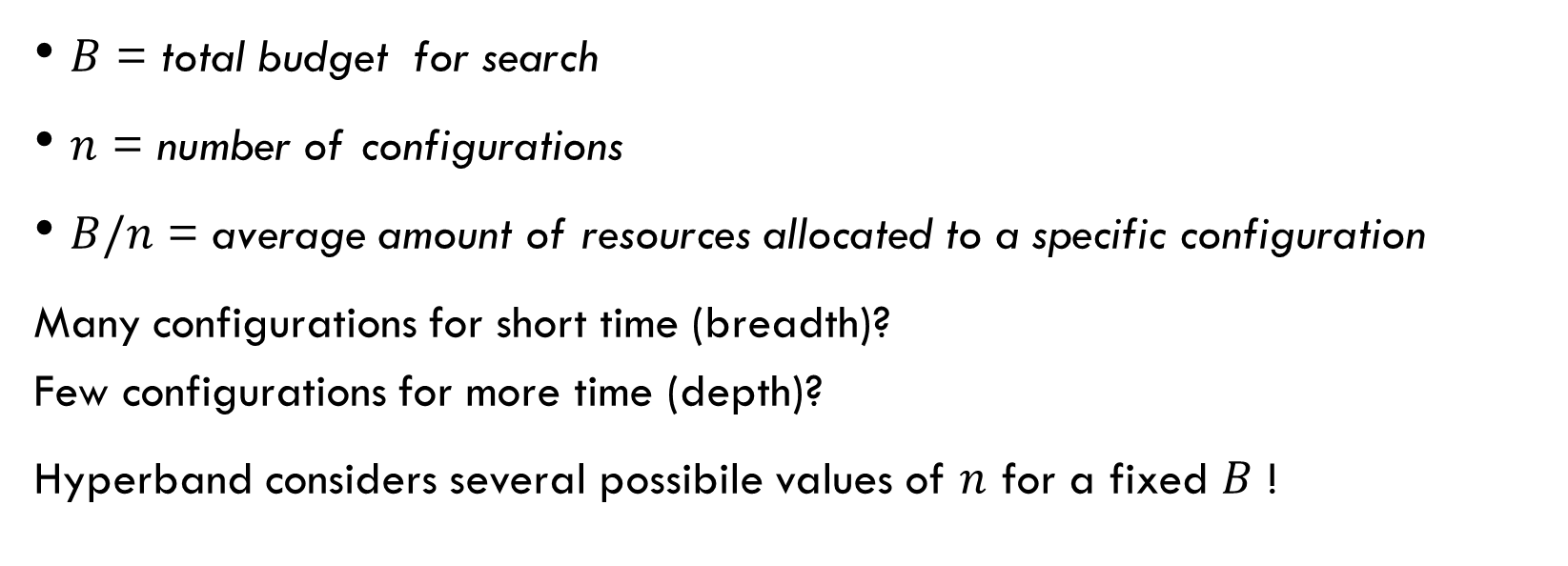

Hyperband: $n vs B/n$ trade-off
$B$ = total budget for search
$n$ = number of configurations
$B/n$ = average amount of resources allocated to a specific configuration
Many configurations for short time (breadth)? Few configurations for more time (depth)?
Hyperband considers several possibile values of $n$ for a fixed $B$ !

